Slide 1
TRAFFIC MANAGEMENT SYSTEM
IOT_PHASE 4:Development part 2

Slide 2
Introduction:
Traffic management is the application of specific traffic control practices, within a defined policy framework, over a length of road or an area, to achieve specified objectives which may be set by national, state or local governments.
A traffic management plan involves planning and controlling the movement of people and goods within an area. This can include stationary and moving traffic, pedestrians, cyclists, and vehicles. The goal of traffic management is to keep this movement orderly and efficiently to minimise risk at the workplace
This project is using arduini uno.

Slide 3
PROGRAM 1:
COMPONENTS:
Arduino uno
4 LED’s
2 PushButton
Wires

Slide 4
CODING
const int mainRoadRedPin = 2;
const int mainRoadGreenPin = 3;
const int sideRoadRedPin = 4;
const int sideRoadGreenPin = 5;
const int mainRoadSensorPin = 6;
const int sideRoadSensorPin = 7;

Slide 5
void setup() {
pinMode(mainRoadRedPin, OUTPUT);
pinMode(mainRoadGreenPin, OUTPUT);
pinMode(sideRoadRedPin, OUTPUT);
pinMode(sideRoadGreenPin, OUTPUT);
pinMode(mainRoadSensorPin, INPUT_PULLUP);
pinMode(sideRoadSensorPin, INPUT_PULLUP);
}

Slide 6
void loop() {
// Check if there are vehicles on the main road
if (digitalRead(mainRoadSensorPin) == LOW) {
// Main road has vehicles, so stop side road traffic
digitalWrite(mainRoadRedPin, LOW);
digitalWrite(mainRoadGreenPin, HIGH);
digitalWrite(sideRoadRedPin, HIGH);
digitalWrite(sideRoadGreenPin, LOW);
} else if (digitalRead(sideRoadSensorPin) == LOW) {
// Side road has vehicles, so stop main road traffic

Slide 7
digitalWrite(mainRoadRedPin, HIGH);
digitalWrite(mainRoadGreenPin, LOW);
digitalWrite(sideRoadRedPin, LOW);
digitalWrite(sideRoadGreenPin, HIGH);
} else {
// No vehicles, all lights are red (4-way stop)
digitalWrite(mainRoadRedPin, LOW);
digitalWrite(mainRoadGreenPin, HIGH);
digitalWrite(sideRoadRedPin, LOW);
digitalWrite(sideRoadGreenPin, HIGH);
}}

Slide 8
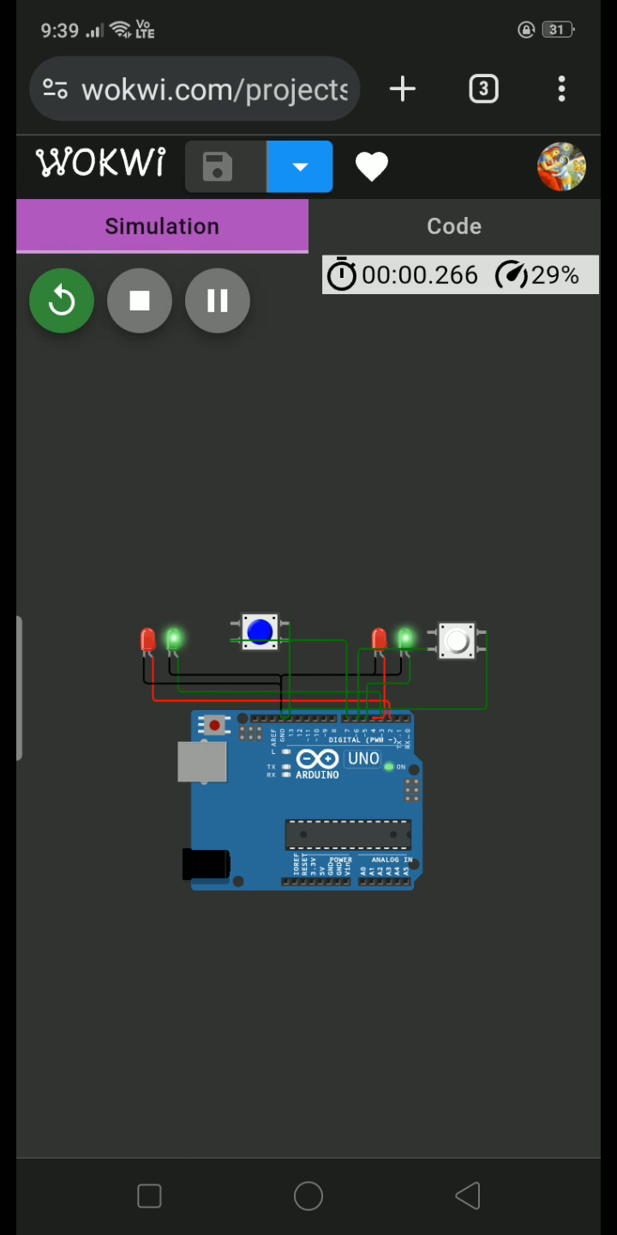
Output(video)
This output used only in two roads.
WOKWI project link:
https://wokwi.com/projects/379571034449458177

Slide 9
Program 2 :
COMPONENTS:
Arduino uno
4 LED’s
2 PushButton
Wires

Slide 10
CODING:
const int mainRoadRedPin = 2;
const int mainRoadGreenPin = 3;
const int mainRoadYellowPin=11;
const int leftRoadRedPin = 4;
const int leftRoadGreenPin = 5;
const int leftRoadYellowPin=8;
const int rightRoadRedPin = 10;
const int rightRoadGreenPin = 6;
const int rightRoadYellowPin =9;
const int mainRoadSensorPin = 7;
const int leftRoadSensorPin =13;
const int rightRoadSensorPin =12;
}

Slide 11
void setup() {
pinMode(mainRoadRedPin, OUTPUT);
pinMode(mainRoadGreenPin, OUTPUT);
pinMode(mainRoadYellowPin, OUTPUT);
pinMode(leftRoadRedPin, OUTPUT);
pinMode(leftRoadGreenPin, OUTPUT);
pinMode(leftRoadYellowPin, OUTPUT);
pinMode(rightRoadRedPin, OUTPUT);
pinMode(rightRoadGreenPin, OUTPUT);
pinMode(rightRoadYellowPin, OUTPUT);
pinMode(mainRoadSensorPin, INPUT_PULLUP);
pinMode(leftRoadSensorPin, INPUT_PULLUP);
pinMode(rightRoadSensorPin, INPUT_PULLUP);
}

Slide 12
void loop() {
// Check if there are vehicles on the main road
if (digitalRead(mainRoadSensorPin) == HIGH) {
// Main road has vehicles, so stop side road traffic
digitalWrite(mainRoadRedPin, HIGH);
digitalWrite(mainRoadGreenPin,LOW);
digitalWrite(mainRoadYellowPin, LOW);
digitalWrite(leftRoadRedPin, LOW);
digitalWrite(leftRoadGreenPin,LOW);
digitalWrite(leftRoadYellowPin, HIGH);
digitalWrite(rightRoadRedPin, LOW);
digitalWrite(rightRoadGreenPin, HIGH);
digitalWrite(rightRoadYellowPin, LOW);
}

Slide 13
else if (digitalRead(leftRoadSensorPin) ==HIGH) {
// left road has vehicles, so stop main road traffic
digitalWrite(mainRoadRedPin, HIGH);
digitalWrite(mainRoadGreenPin, LOW);
digitalWrite(mainRoadYellowPin, LOW);
digitalWrite(leftRoadRedPin, LOW);
digitalWrite(leftRoadGreenPin,HIGH);
digitalWrite(leftRoadYellowPin, LOW);
digitalWrite(rightRoadRedPin, LOW);
digitalWrite(rightRoadGreenPin, LOW);
digitalWrite(rightRoadYellowPin, HIGH);
}

Slide 14
else if (digitalRead(rightRoadSensorPin) == HIGH) {
// right road has vehicles, so stop main road traffic
digitalWrite(mainRoadRedPin, LOW);
digitalWrite(mainRoadGreenPin, LOW);
digitalWrite(mainRoadYellowPin, HIGH);
digitalWrite(leftRoadRedPin,HIGH);
digitalWrite(leftRoadGreenPin, LOW);
digitalWrite(leftRoadYellowPin, LOW);
digitalWrite(rightRoadRedPin, LOW);
digitalWrite(rightRoadGreenPin, HIGH);
digitalWrite(rightRoadYellowPin, LOW);
}

Slide 15
else {
// No vehicles, all lights are red (4-way stop)
digitalWrite(mainRoadRedPin, LOW);
digitalWrite(mainRoadGreenPin, HIGH);
digitalWrite(mainRoadYellowPin, LOW);
digitalWrite(leftRoadRedPin, LOW);
digitalWrite(leftRoadGreenPin, HIGH);
digitalWrite(leftRoadYellowPin, LOW);
digitalWrite(rightRoadRedPin, LOW);
digitalWrite(rightRoadGreenPin, HIGH);
digitalWrite(rightRoadYellowPin, LOW);
}
}

Slide 16
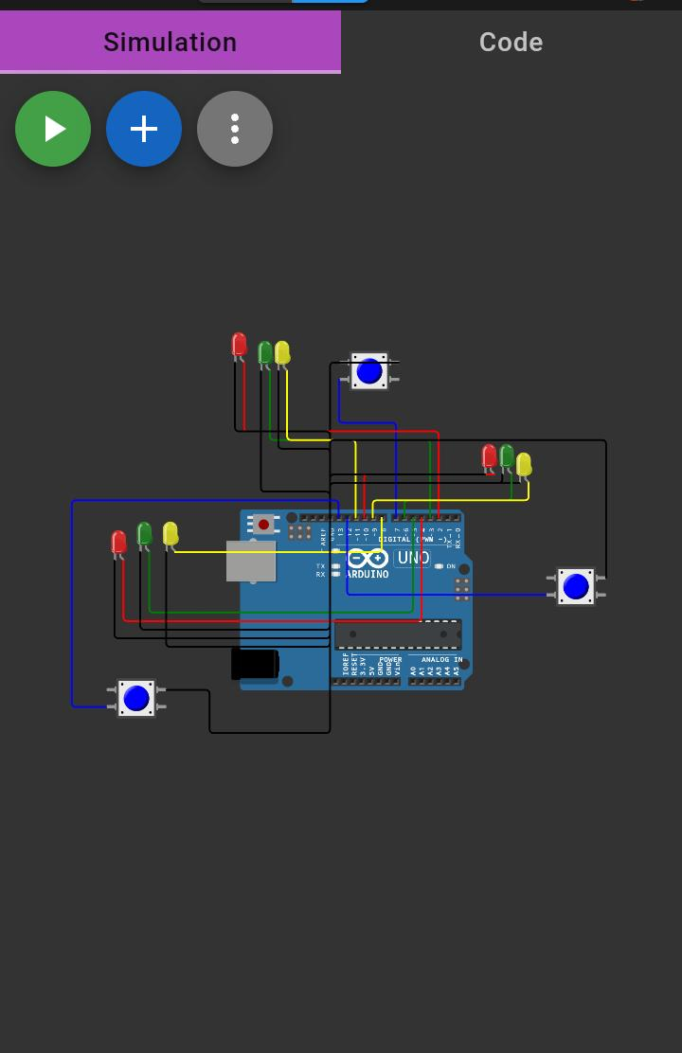
Output(image)
This is the output for 3 roads
WOKWI PROJRCT 2 LINK:
https://wokwi.com/projects/379571034449458177

Slide 17
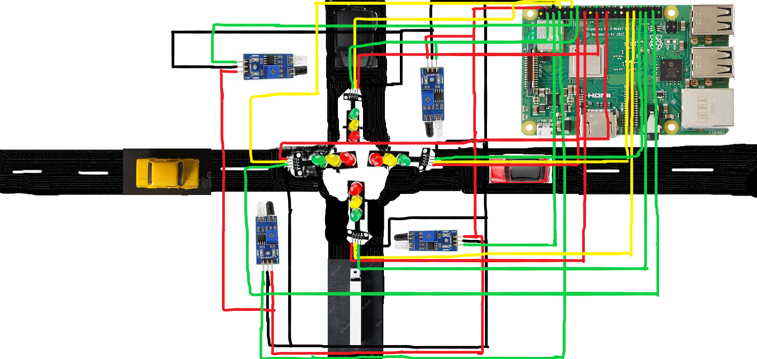
OUTPUT IMAGE:
This is the output for 4 way roads

Slide 18
Using Raspbeery pi 3
Components:
Raspberry pi 3
IR sensors
4 sets of 3 LED’s
wires

Slide 19
Thank You !!!
By team Mates:
M . Santhosh Kumar

